Slide 1

SRM INSTITUTE OF SCIENCE AND TECHNOLOGY RAMAPURAM FACULTY OF ENGINEERING AND TECHNOLOGY DEPARTMENT OF INFORMATION TECHNOLOGY 18CSP107L-Minor Project Final Review Smart Living with DigiReflect: An IoT Platform for Efficient Task Management
Athira.P-RA2111008020123
Sree Durga Devi.S-RA2111008020135
Anisha.K-RA2111008020151
Dr. K. Danesh
Assistant Professor

Slide 2
ABSTRACT
DigiReflect: An IoT Platform for Efficient Task Management integrates various productivity tools, including real-time date and time display, a calendar, customizable affirmations, and a note-taking system.
Built with Python's Tkinter for the GUI and TensorFlow for sign language recognition, it provides an accessible interface for users. The dashboard opens with essential features prominently displayed, allowing easy interaction.
A key functionality is the integrated sign language detection, which operates in a separate thread, enabling gesture recognition while keeping other features active.
This application promotes organization and accessibility, catering particularly to individuals who communicate through sign language.
The seamless interaction between components enhances the user experience, making it a comprehensive tool for daily activities. Overall, it combines productivity and advanced technology to create a user-friendly environment.

Slide 3
PROBLEM IDENTIFICATION
PROBLEM STATEMENT:
The application seeks to create a personal dashboard with real-time sign language detection, note management, and motivational affirmations. It must accurately interpret gestures, allow seamless note editing, and offer an easy-to-navigate interface.
SOLUTION:
A Tkinter-based dashboard integrates a trained TensorFlow model for real-time sign language detection, a note-taking module, and motivational affirmations. Webcam frames are preprocessed for compatibility with the model, while threading ensures responsiveness. The application allows easy note editing, displays a calendar, and updates time and date automatically, providing an accessible, interactive personal dashboard.

Slide 4
DISADVANTAGES
Limited Sign Detection Scope: Recognizes only a specific set of signs, which may not cover all communication needs in sign language.
High Resource Usage: Continuous video processing and machine learning can be resource-intensive, potentially slowing down system performance on lower-spec devices.
Dependency on Camera Quality: Accurate detection requires a good-quality camera and consistent lighting, limiting functionality in low-light conditions or with lower-resolution cameras.
Privacy Concerns: Requires camera access, which could raise privacy issues for some users who may be uncomfortable with continuous video monitoring.
Model Accuracy and Generalization: The model may struggle to accurately interpret varied user gestures, especially with differences in hand positioning or lighting, potentially leading to errors.

Slide 5
MOTIVATION OF THE PROJECT
The motivation behind this project stems from the need to enhance inclusivity, organization, and daily motivation through technology. Sign language detection supports accessibility, making it easier for individuals with hearing or speech impairments to communicate in various environments. Additionally, integrating note-taking, real-time calendar updates, and affirmations within a single dashboard encourages productivity, positivity, and self-reflection. The goal is to build a smart, personal assistant that empowers users to manage daily tasks and stay motivated while embracing the transformative power of artificial intelligence and computer vision for a more inclusive future.

Slide 6
PROPOSED SYSTEM
Integrated Dashboard: Combines sign language recognition, note management, calendar, and affirmations in one interface.
Real-Time Sign Language Recognition: Uses a custom-trained model to detect and classify specific sign language gestures for non-verbal communication.
Enhanced Note Module: Allows users to add, edit, and display notes easily, enabling better task and thought management.
Calendar Feature: Supports event scheduling and tracking for streamlined time management.
Affirmations Display: Centralized, positive affirmations designed to promote well-being and motivation throughout the day.
Inclusive Design: Aims to support a broader range of users, including those needing non-verbal, gesture-based interaction.

Slide 7
ADVANTAGES
Enhanced Accessibility: Facilitates non-verbal communication for users with speech or hearing impairments through real-time sign language detection.
Multi-Functionality: Combines multiple features (notes, calendar, affirmations) in a single dashboard, reducing the need for multiple apps.
Improved Productivity: Allows users to manage tasks, notes, and schedules conveniently, fostering better organization.
Positive Reinforcement: Displays motivational affirmations to support a positive mindset throughout the day.
User-Friendly: Simple, intuitive design with easy-to-navigate features, catering to diverse user needs.
Real-Time Interaction: Instantaneous gesture recognition ensures prompt response, making the system feel responsive and reliable.

Slide 8
SYSTEM REQUIREMENTS
SOFTWARER EQUIREMENTS:
Programming Language:Python3.x
Libraries:
OpenCV
Tkcalendar
Tkinter
TensorFlow
Matplotlib
NumPy
Operating System:
Windows10 or higher
Raspberry pi OS
Integrated Development Environment(IDE):
Thonny
Visual Studio Code(VSCode)

Slide 9
SYSTEM REQUIREMENTS
HARDWARE REQUIREMENTS:
Web cam: least 720p resolution for clear image capture.
Computer Specifications: Processor- Intel i3 or above (or equivalent AMD),RAM- Minimum 4 GB (8 GB or higher recommended for TensorFlow and OpenCV tasks), Storage- At least 500 MB of free space for the project files, libraries, and trained model.
Microcontroller: Raspberry pi pico

Slide 10
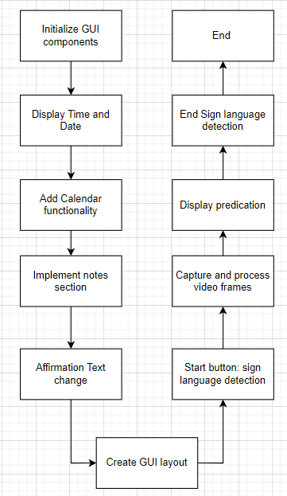
SYSTEM ARCHITECTURE

Slide 11
Full Modules presentation with algorithms
Dashboard Module:
Displays the date, time, affirmations, a note-taking section, and allows users to view a calendar.
It also integrates the sign language detection functionality, controlled via buttons.
Algorithm:
Initialize GUI: Create a Tkinter window and set its properties (title, size, background).
Display Current Time: Use datetime to fetch and update the current time every second.
Show Calendar: Implement a calendar using tkcalendar, allowing users to select dates.
Affirmations: Create a list of affirmations and cycle through them when clicked.
Notes Section: Allow users to add, edit, and display notes in a text area.

Slide 12
Full Modules presentation with algorithms
Sign language detector module:
Initialize Webcam: Use OpenCV to access the webcam.
Frame Capture: Capture video frames continuously.
Preprocess Frames: Convert frames to grayscale.
Resize images to fit the model input.
Load Trained Model: Use TensorFlow to load the pre-trained sign language detection model.
Make Predictions: Predict the sign language gesture from the processed frame and display the result on the frame.

Slide 13
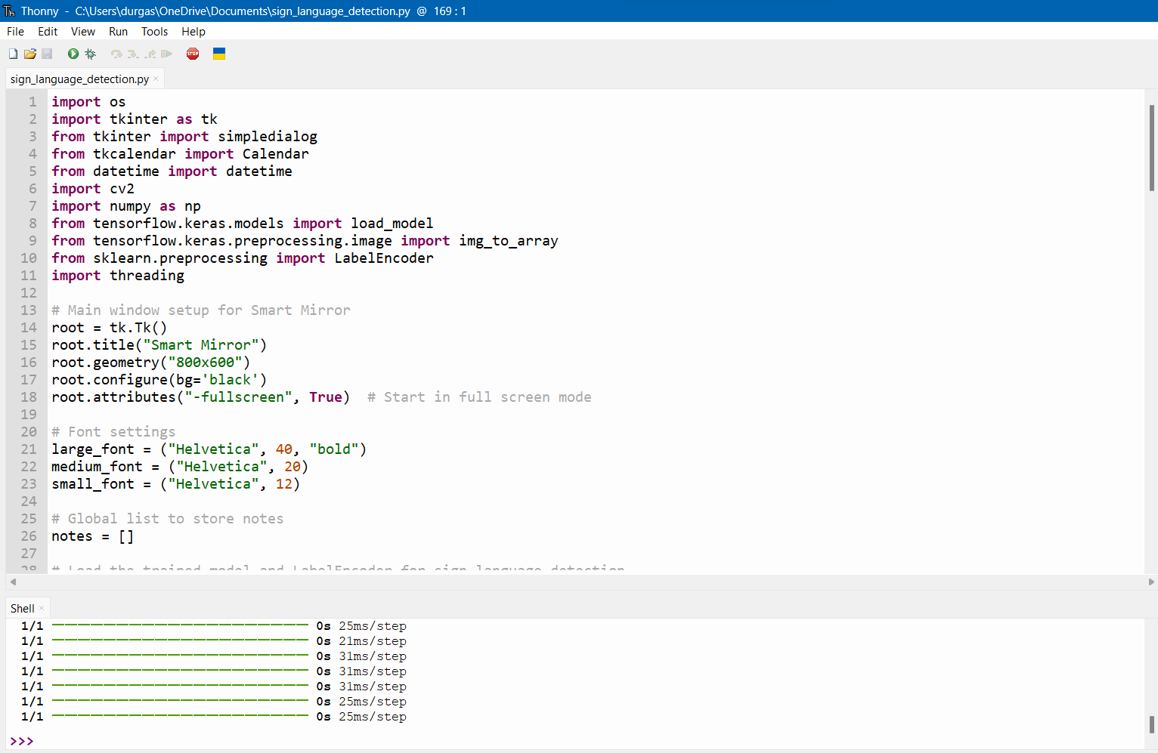
SAMPLE CODE

Slide 14
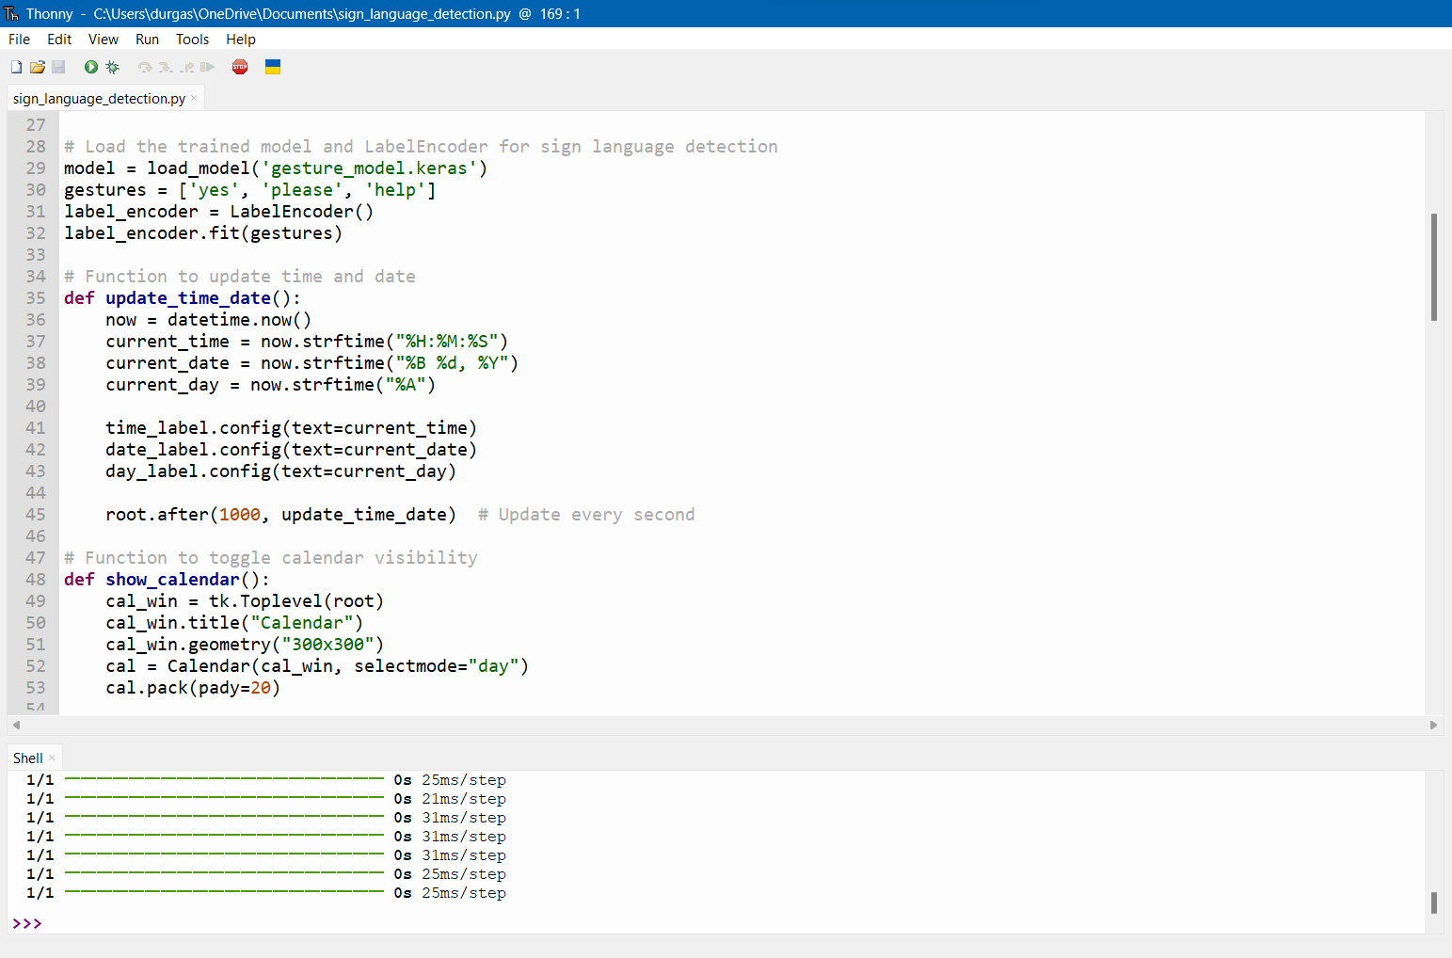
SAMPLE CODE

Slide 15
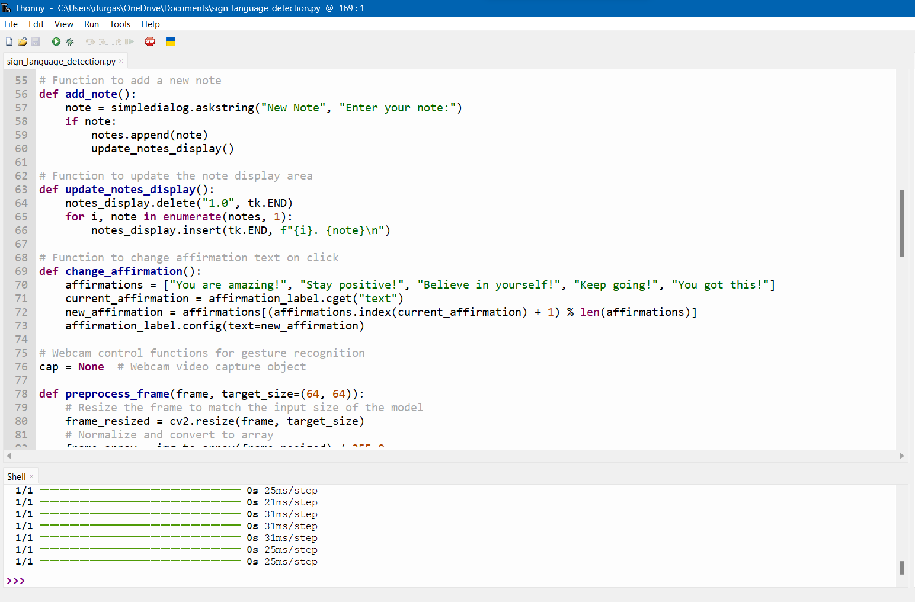
SAMPLE CODE

Slide 16
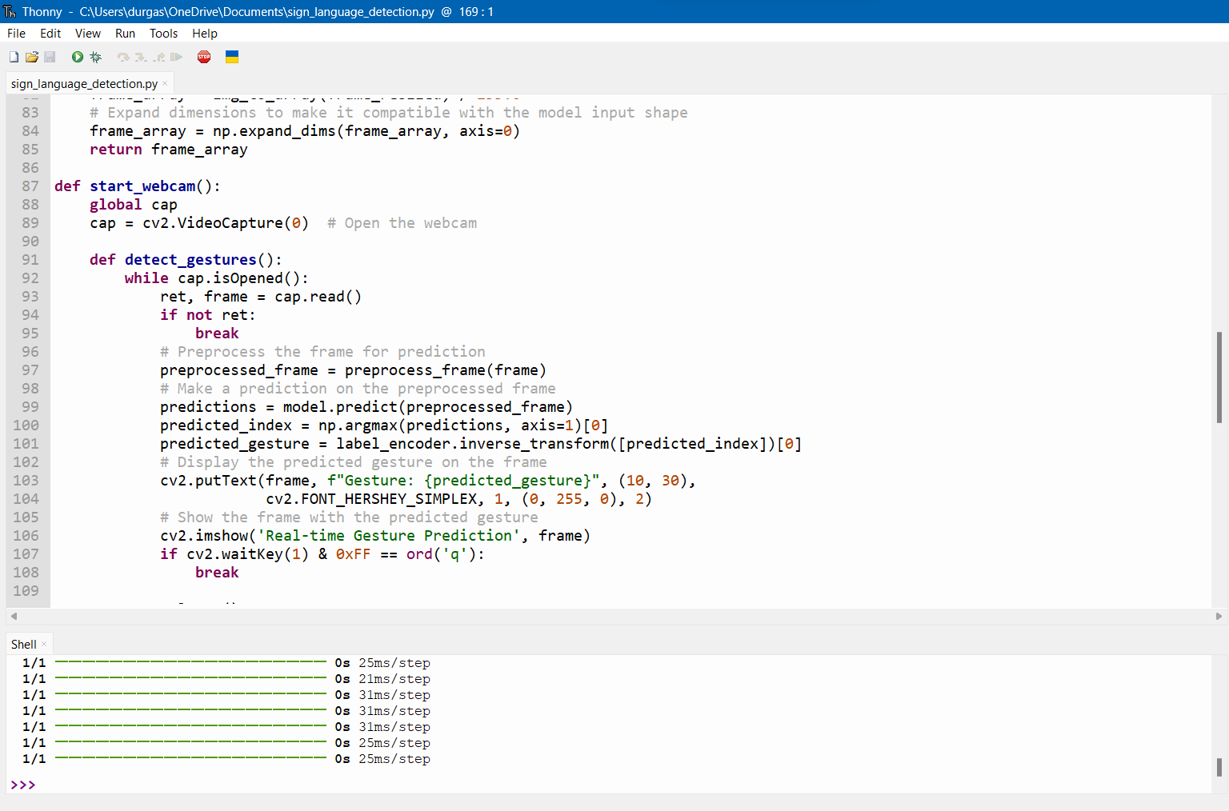
SAMPLE CODE

Slide 17
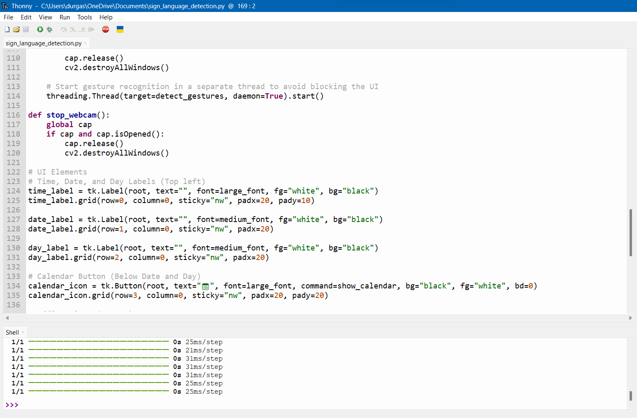
SAMPLE CODE

Slide 18
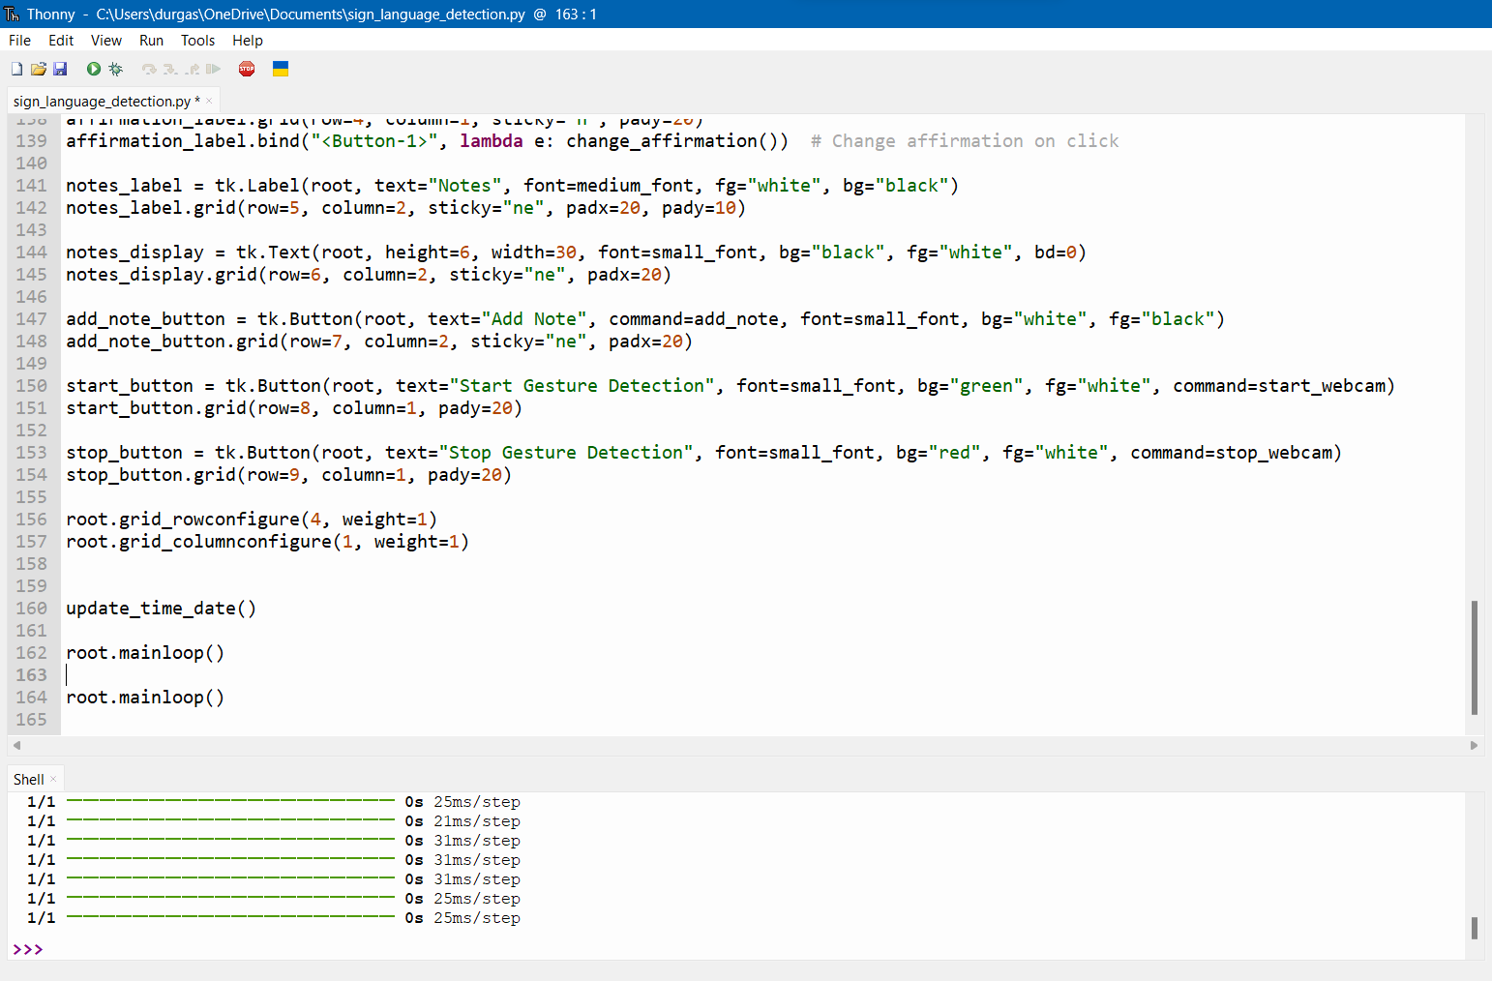
SAMPLE CODE

Slide 19
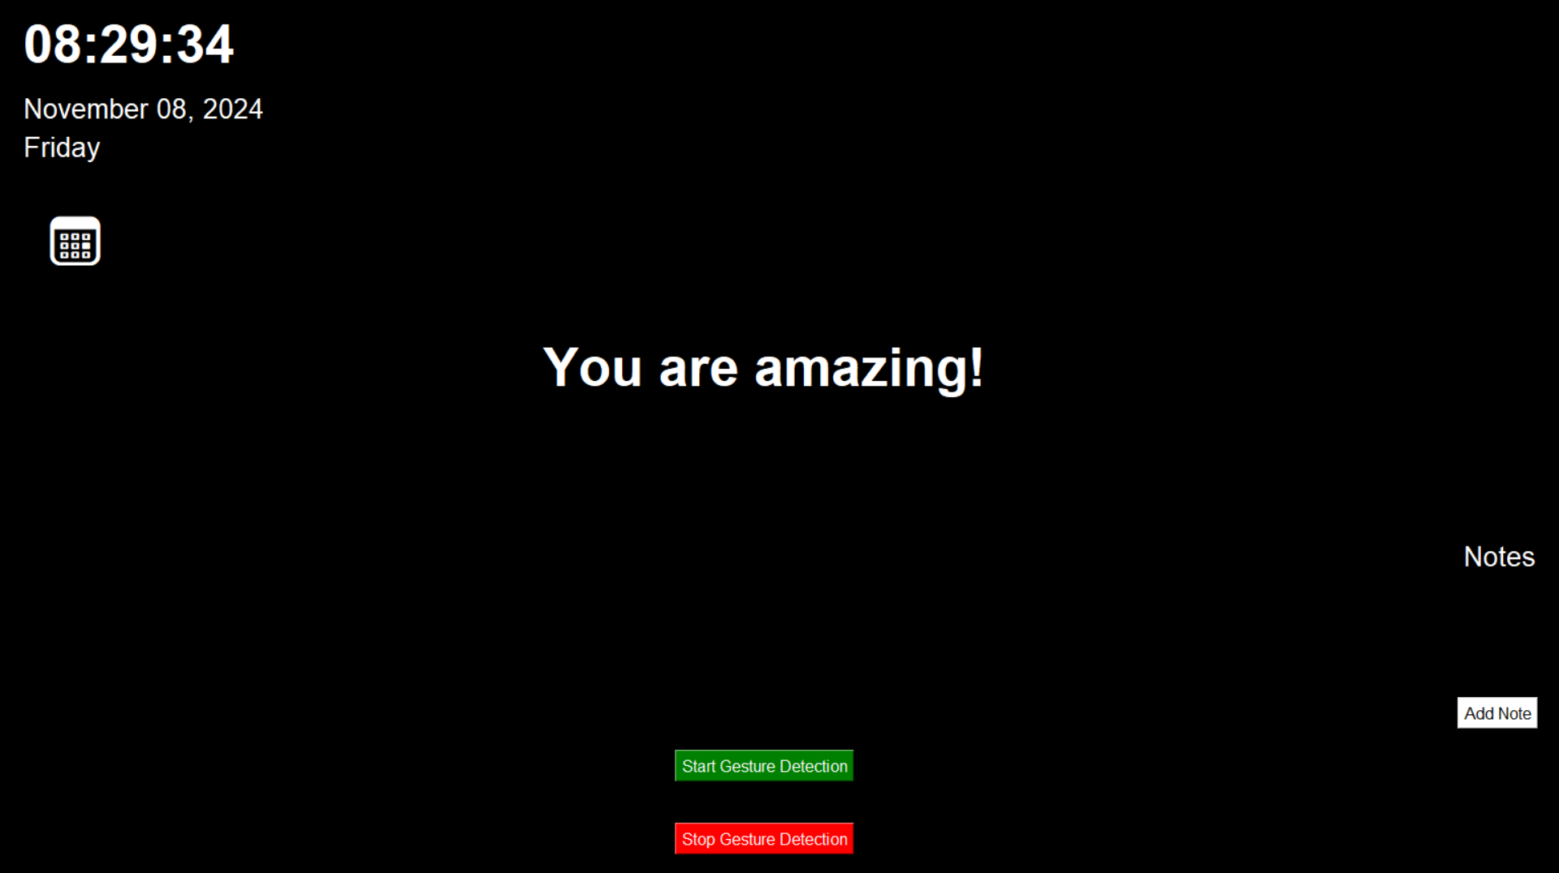
DASHBOARD INTERFACE

Slide 20
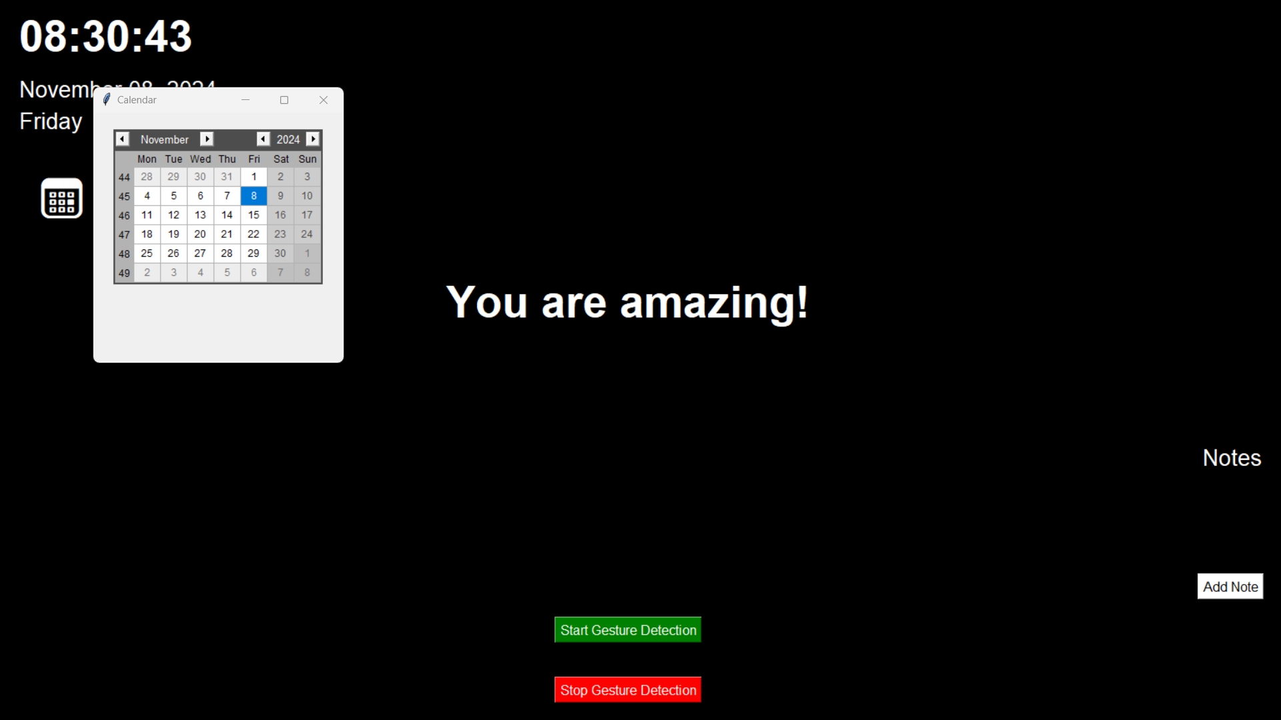
CALENDAR POP UP

Slide 21
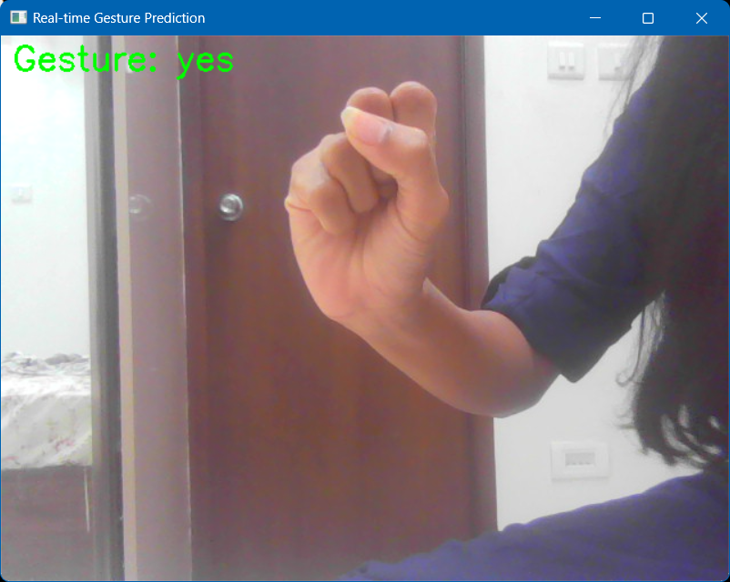
SMART MIRROR DISPLAY

Slide 22
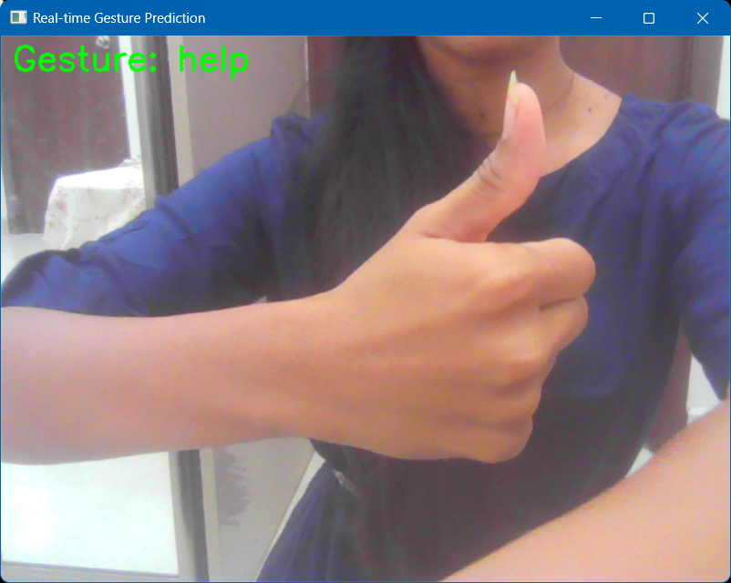
SMART MIRROR DISPLAY

Slide 23
CONCLUSION
In conclusion, the application successfully integrates multiple productivity tools to enhance user experience. The real-time display of date and time, interactive calendar, affirmations, and note-taking functionality offers users a comprehensive platform for managing daily tasks.
The inclusion of sign language detection enables better communication for users who rely on gestures, making the application more inclusive.
Overall, this project not only demonstrates the practical application of Python and machine learning technologies but also addresses the importance of accessibility in everyday tools.

Slide 24
FUTURE ENHANCEMENT
To improve the functionality and usability of the application, the following enhancements are recommended:
Enhanced Sign Language Detection: Expand the model to recognize more gestures and improve accuracy by incorporating a larger dataset.
User Profiles: Allow users to create profiles to save personalized settings, notes, and affirmations.
Data Export: Implement functionality to export notes and affirmations to a file for backup.
Mobile Application: Develop a mobile version of the dashboard for easier access on various devices.
Integration with Other APIs: Integrate with external APIs (e.g., weather, task management) to provide more comprehensive information.

Slide 25
THANK YOU

